Slide 1
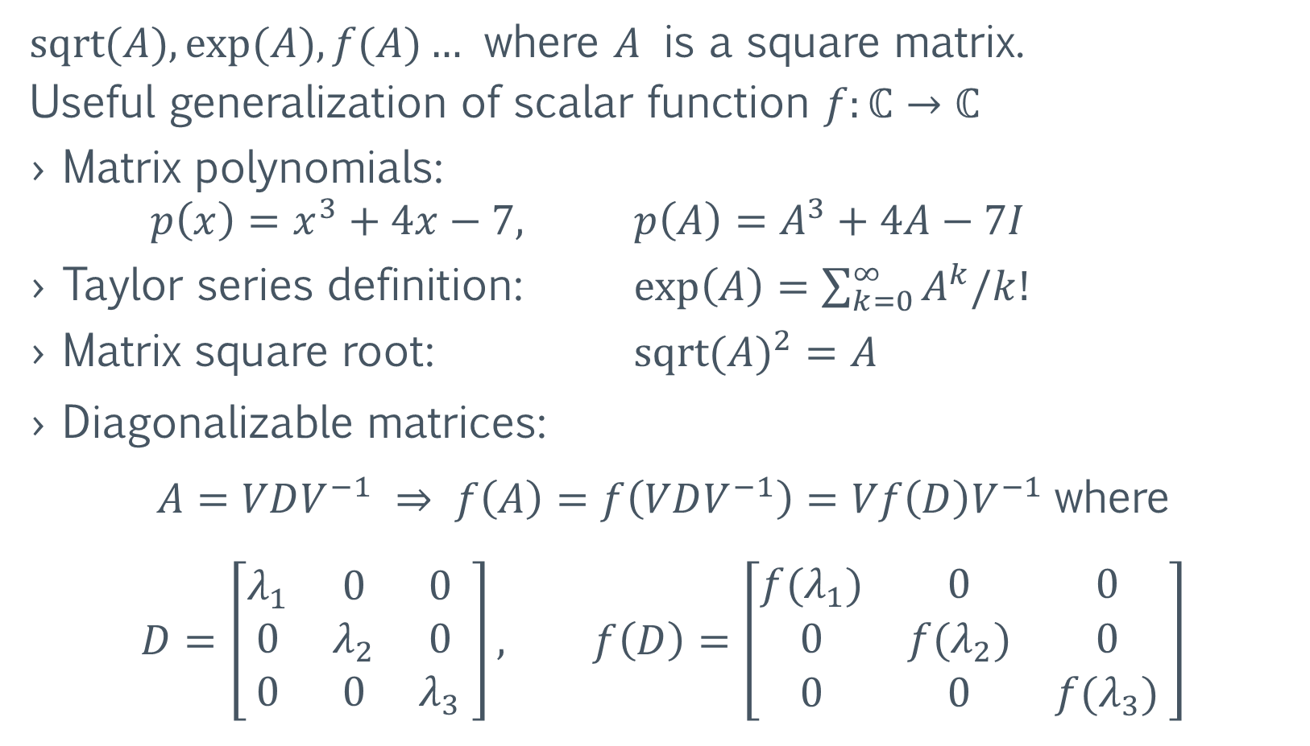
Matrix Functions
$sqrt⁡(A), exp⁡(A), f(A)…$ where $A$ is a square matrix.
Useful generalization of scalar function $f:ℂ→ℂ$
Matrix polynomials:
$p\left(x\right)=x^{3}+4x−7,$ $p\left(A\right)=A^{3}+4A−7I$
Taylor series definition: $exp\left(A\right)=\sum_{k=0}^{∞}{A^{k}/k!}$
Matrix square root: ${sqrt(A)}^{2}=A$
Diagonalizable matrices:
$A=VDV^{−1} ⇒ f\left(A\right)=f\left(VDV^{−1}\right)=Vf\left(D\right)V^{−1}$where
$$D=\left[\begin{matrix}λ_{1} & 0 & 0 \\ 0 & λ_{2} & 0 \\ 0 & 0 & λ_{3}\end{matrix} \right], f\left(D\right)=\left[\begin{matrix}{f(λ}_{1}) & 0 & 0 \\ 0 & {f(λ}_{2}) & 0 \\ 0 & 0 & {f(λ}_{3})\end{matrix} \right]$$

Slide 2
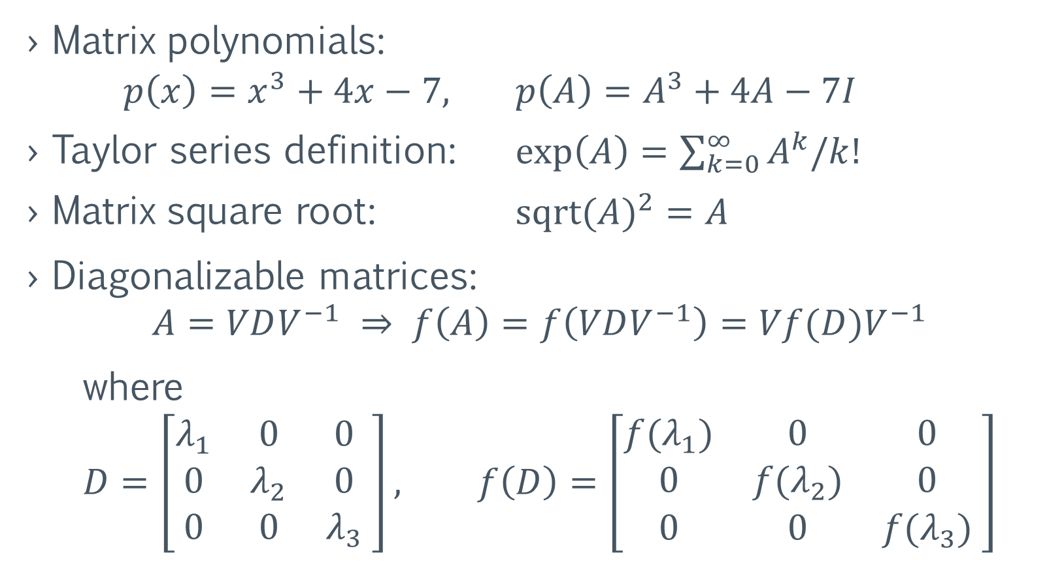
Matrix Functions – examples
Matrix polynomials:
$p\left(x\right)=x^{3}+4x−7,$ $p\left(A\right)=A^{3}+4A−7I$
Taylor series definition: $exp\left(A\right)=\sum_{k=0}^{∞}{A^{k}/k!}$
Matrix square root: ${sqrt(A)}^{2}=A$
Diagonalizable matrices:
$$A=VDV^{−1} ⇒ f\left(A\right)=f\left(VDV^{−1}\right)=Vf(D)V^{−1}$$
where
$$D=\left[\begin{matrix}λ_{1} & 0 & 0 \\ 0 & λ_{2} & 0 \\ 0 & 0 & λ_{3}\end{matrix} \right], f\left(D\right)=\left[\begin{matrix}{f(λ}_{1}) & 0 & 0 \\ 0 & {f(λ}_{2}) & 0 \\ 0 & 0 & {f(λ}_{3})\end{matrix} \right]$$

Slide 3
Computation of matrix functions with fully automatic Schur-Parlett and Rational Krylov methods.
Roberto Zanotto

Slide 4
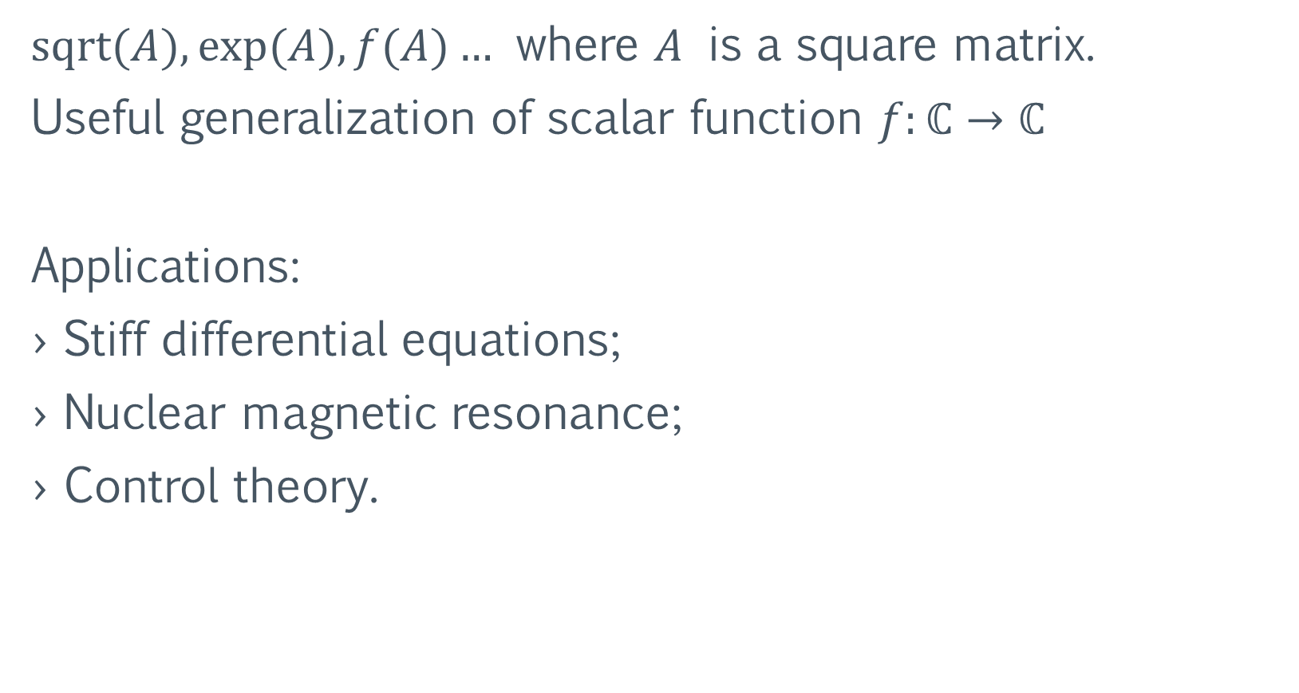
Matrix Functions
$sqrt⁡(A), exp⁡(A), f(A)…$ where $A$ is a square matrix.
Useful generalization of scalar function $f:ℂ→ℂ$
Applications:
Stiff differential equations;
Nuclear magnetic resonance;
Control theory.

Slide 5
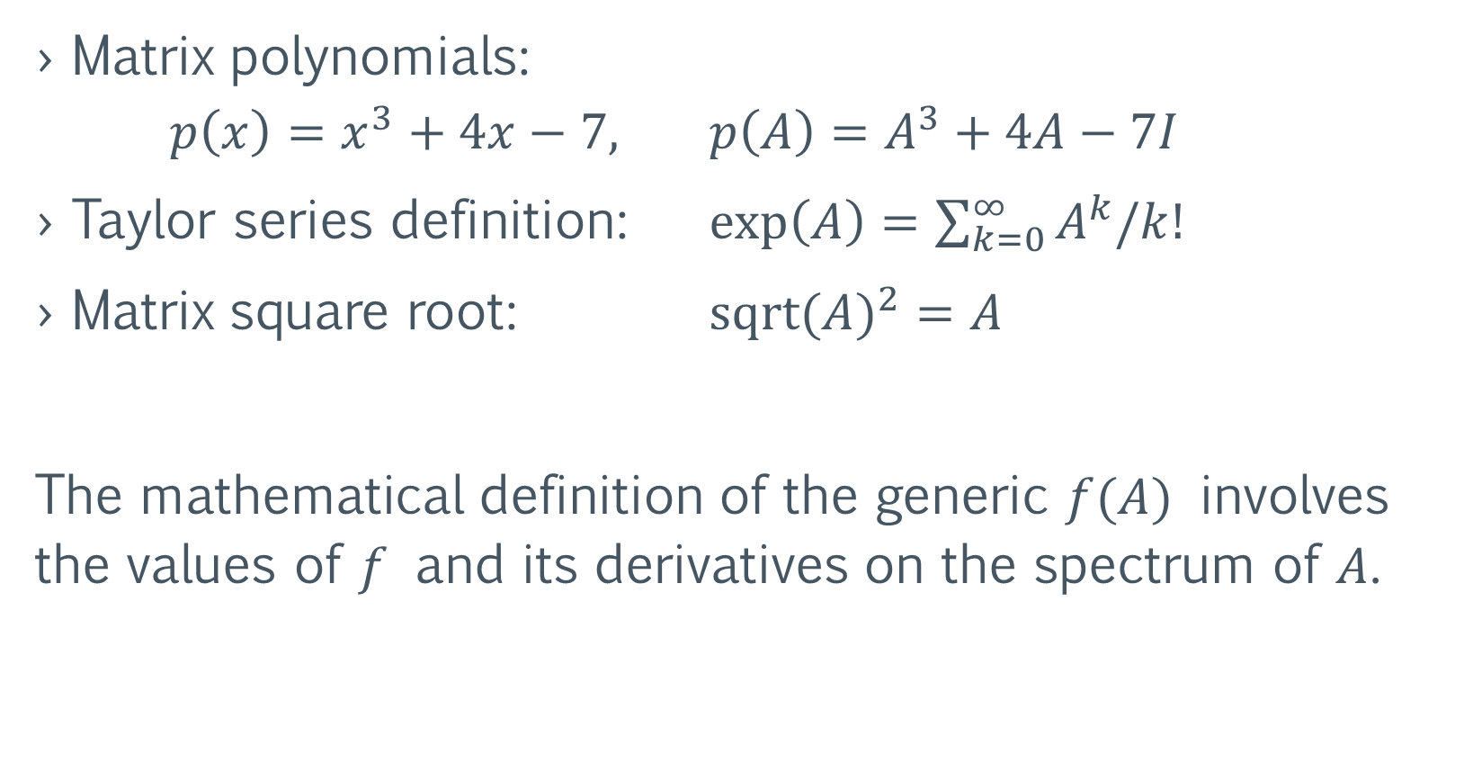
Matrix Functions – examples
Matrix polynomials:
$p\left(x\right)=x^{3}+4x−7,$ $p\left(A\right)=A^{3}+4A−7I$
Taylor series definition: $exp\left(A\right)=\sum_{k=0}^{∞}{A^{k}/k!}$
Matrix square root: ${sqrt(A)}^{2}=A$
The mathematical definition of the generic $f(A)$ involves the values of $f$ and its derivatives on the spectrum of $A$.

Slide 6
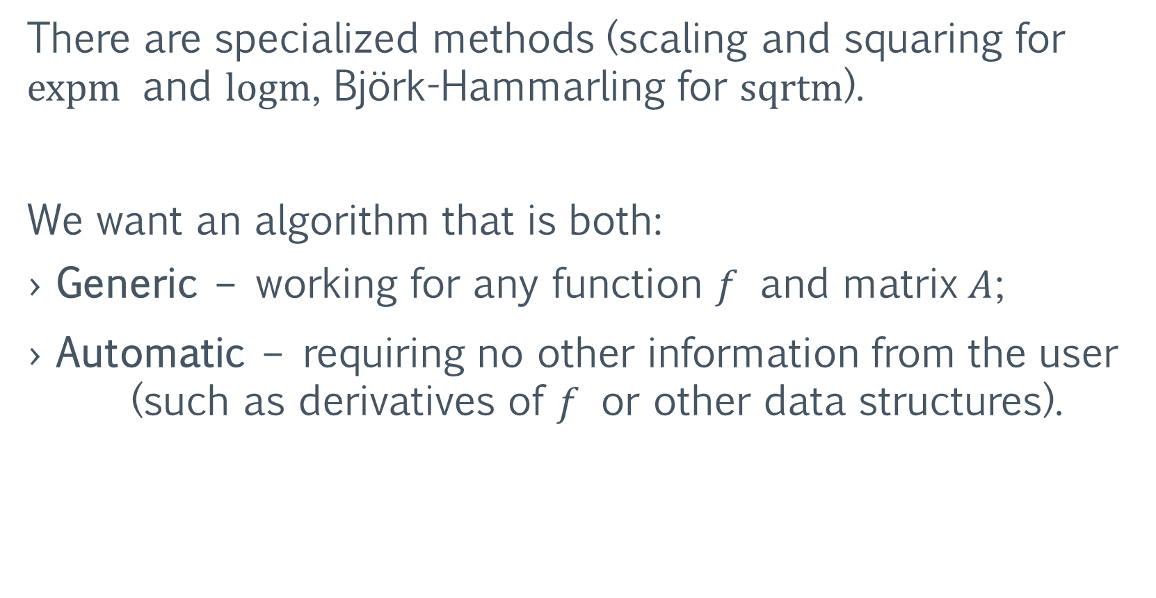
Computation of Matrix Functions
There are specialized methods (scaling and squaring for expm and logm, Björk-Hammarling for sqrtm).
We want an algorithm that is both:
Generic – working for any function $f$ and matrix $A$;
Automatic – requiring no other information from the user (such as derivatives of $f$ or other data structures).

Slide 7
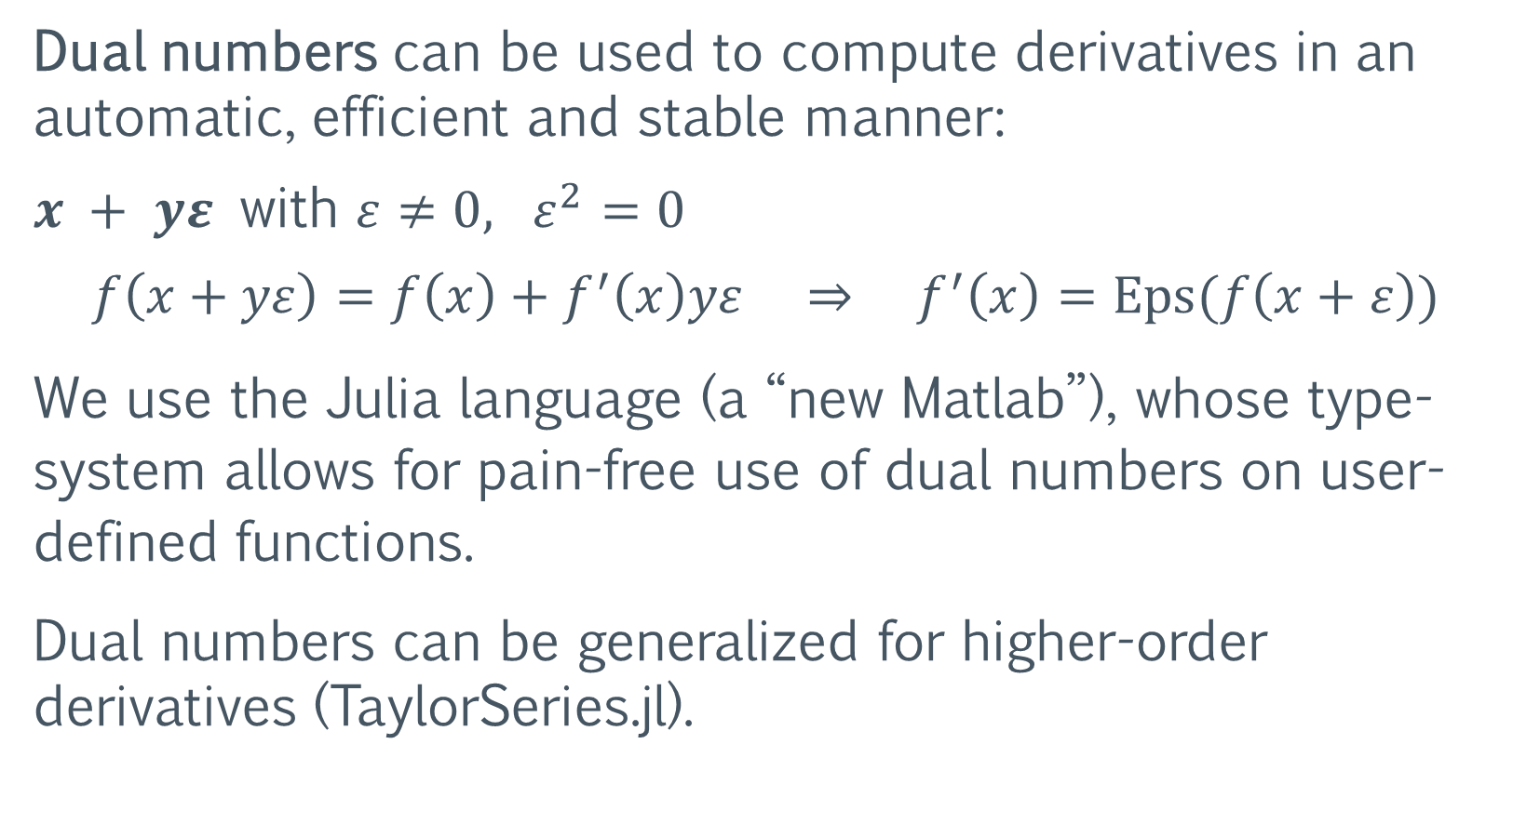
Automatic Differentiation
Dual numbers can be used to compute derivatives in an automatic, efficient and stable manner:
$x + yε$ with $ε≠0, ε^{2}=0$
$$f\left(x+yε\right)=f\left(x\right)+f^{′}\left(x\right)yε ⇒ f^{′}\left(x\right)=Eps(f\left(x+ε\right))$$
We use the Julia language (a “new Matlab”), whose type-system allows for pain-free use of dual numbers on user-defined functions.
Dual numbers can be generalized for higher-order derivatives (TaylorSeries.jl).

Slide 8
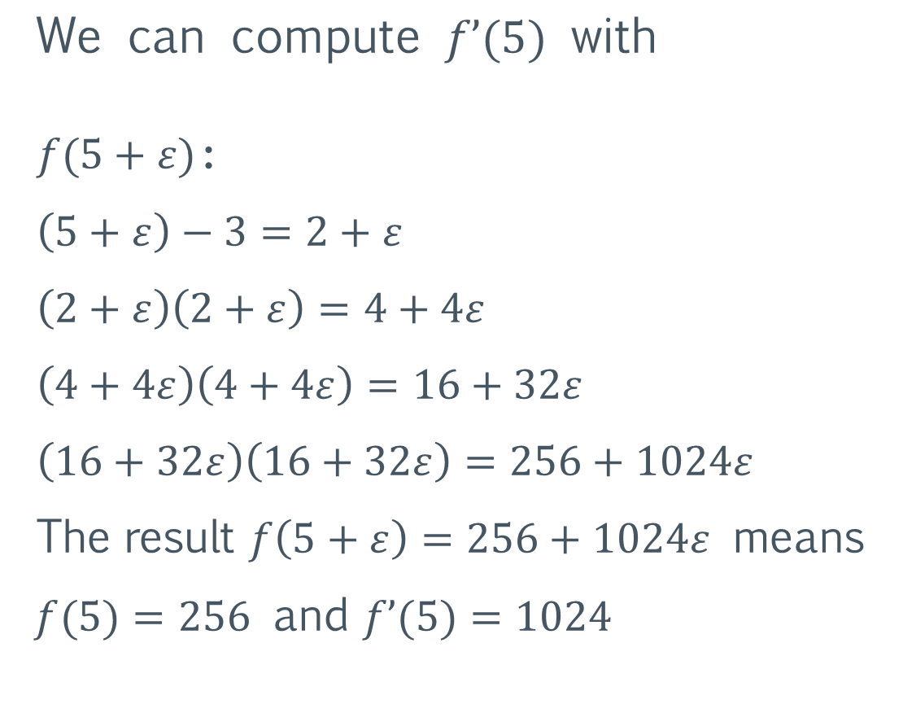

Automatic Differentiation – example
$$f(x) ={(x−3)}^{8}$$
function f(x)
x -= 3
for i = 1:3
x *= x
end
return x
end
$$\text{We} \text{can} \text{compute} f’(5) \text{with}$$
$f(5+ε)$:
$\left(5+ε\right)−3=2+ε$
$\left(2+ε\right)\left(2+ε\right)=4+4ε$
$\left(4+4ε\right)\left(4+4ε\right)=16+32ε$
$\left(16+32ε\right)\left(16+32ε\right)=256+1024ε$
The result $f\left(5+ε\right)=256+1024ε$ means
$f(5)=256$ and $f’(5)=1024$

Slide 9

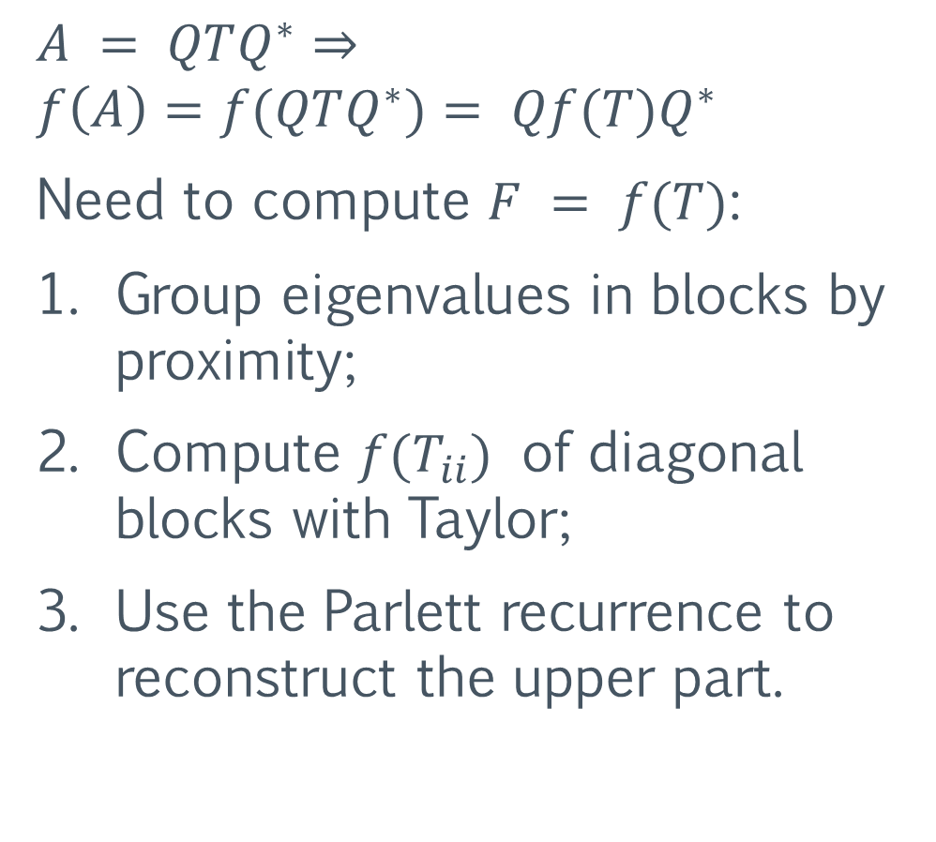
Schur-Parlett – dense matrix functions
Proposed by $\text{Higham} \text{and} \text{Davies} \text{in}\text{ 2003.}$
$$A = QTQ^{∗}⇒$$
$$f\left(A\right)=f(QTQ^{∗})= Qf(T)Q^{∗}$$
Need to compute $F = f(T)$:
Group eigenvalues in blocks by proximity;
Compute $f(T_{ii})$ of diagonal blocks with Taylor;
Use the Parlett recurrence to reconstruct the upper part.

Slide 10

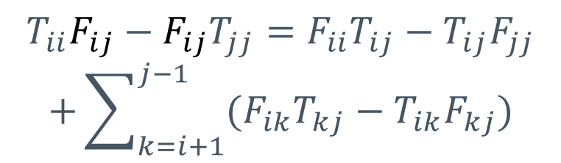
Schur-Parlett – Parlett recurrence
Parlett recurrence made recursive and cache-oblivious.
$$⇒$$
$$T_{ii}F_{ij}−F_{ij}T_{jj}=F_{ii}T_{ij}−T_{ij}F_{jj}$$
$$+\sum_{k=i+1}^{j−1}{(F_{ik}T_{kj}−T_{ik}F_{kj})}$$
$$T_{11}F_{12}−F_{12}T_{22}=F_{11}T_{12}−T_{12}F_{22}$$
~3x speedup for n = 2500

Slide 11

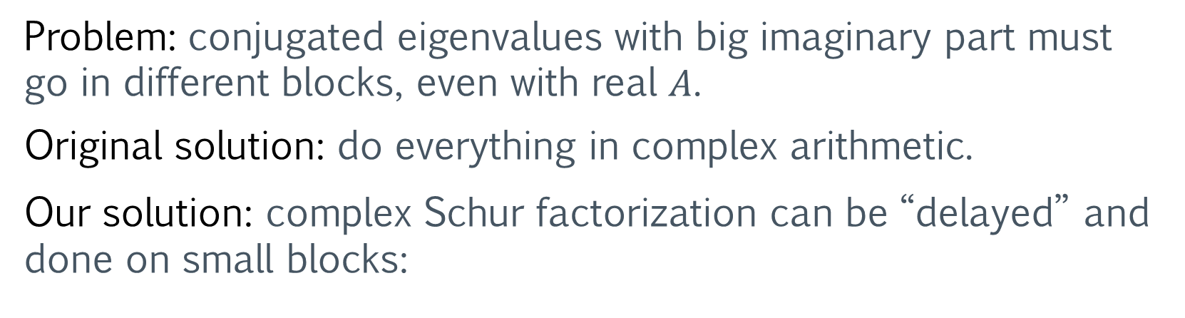

Problem: conjugated eigenvalues with big imaginary part must go in different blocks, even with real $A$.
Original solution: do everything in complex arithmetic.
Our solution: complex Schur factorization can be “delayed” and done on small blocks:
small
complex
Schur
real
Schur
$$⇒$$
$$⇒$$
Also allows for Parlett recurrence in real arithmetic, ~2x speedup for n = 2500 on whole Schur-Parlett.

Slide 12

Schur-Parlett – performance results
The whole procedure typically spends ~2/3 of the time doing $A$’s Schur decomposition (varies depending on the eigenvalues’ distribution).

Slide 13
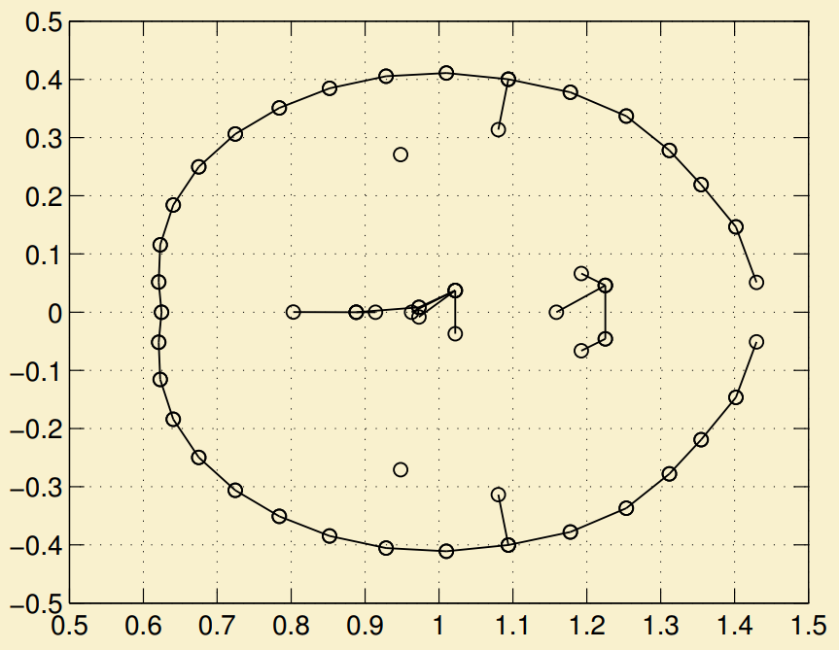
Schur-Parlett – numerical accuracy
 | Specialized method | Schur-Parlett
exp | 1.0e-14 | 1.5e-13
log | 4.0e-14 | 4.1e-14
sqrt | 4.3e-14 | 4.5e-14
Relative error versus Matlab’s Symbolic Toolbox (on 50x50 random matrix).
Boils down to how well the eigenvalues can be clustered.
Can behave badly (7e-4) with “snake” eigenvalues (as shown in original paper, experiment 4)

Slide 14
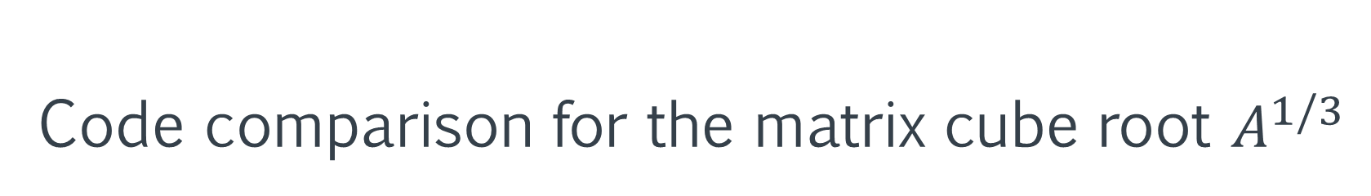
Code comparison for the matrix cube root $A^{1/3}$
Matlab
Our Julia implementation
function r = cuberoot(x, k)
c = 1.0;
for i = 0:k-1
c = c*(1/3 – i);
end
r = c*x^(1/3 - k);
end
funm(A, @cuberoot)
schurparlett((x)->x^(1/3), A)

Slide 15
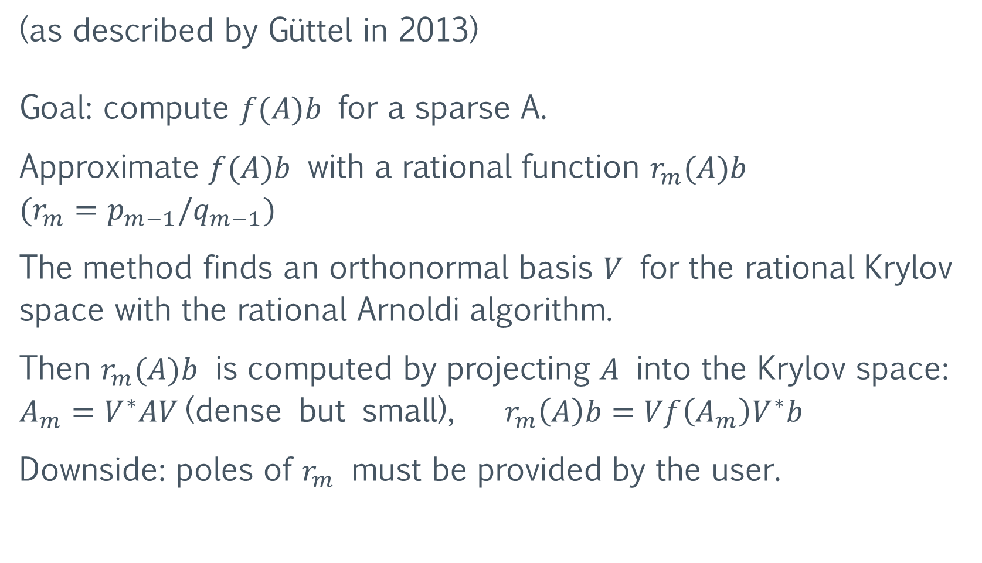
Rational Krylov – sparse matrix functions
(as described by Güttel in 2013)
Goal: compute $f(A)b$ for a sparse A.
Approximate $f(A)b$ with a rational function $r_{m}(A)b$ $(r_{m}=p_{m−1}/q_{m−1})$
The method finds an orthonormal basis $V$ for the rational Krylov space with the rational Arnoldi algorithm.
Then $r_{m}(A)b$ is computed by projecting $A$ into the Krylov space: $A_{m}=V^{∗}AV \text{(}\text{dense} \text{but} \text{small}\text{),} r_{m}\left(A\right)b=Vf\left(A_{m}\right)V^{∗}b$
Downside: poles of $r_{m}$ must be provided by the user.

Slide 16
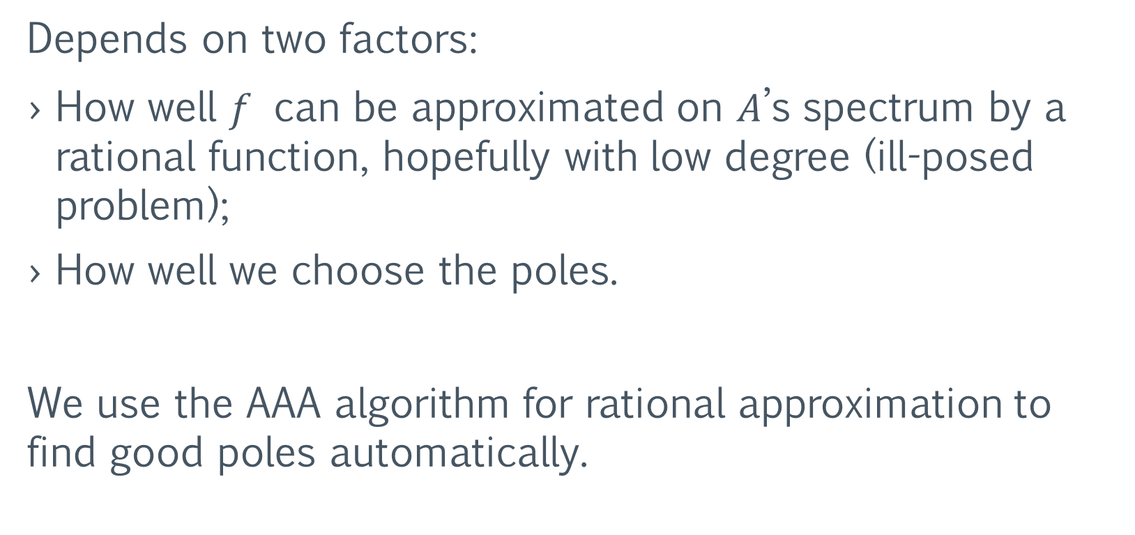
Rational Krylov – approximation accuracy
Depends on two factors:
How well $f$ can be approximated on $A$’s spectrum by a rational function, hopefully with low degree (ill-posed problem);
How well we choose the poles.
We use the AAA algorithm for rational approximation to find good poles automatically.

Slide 17
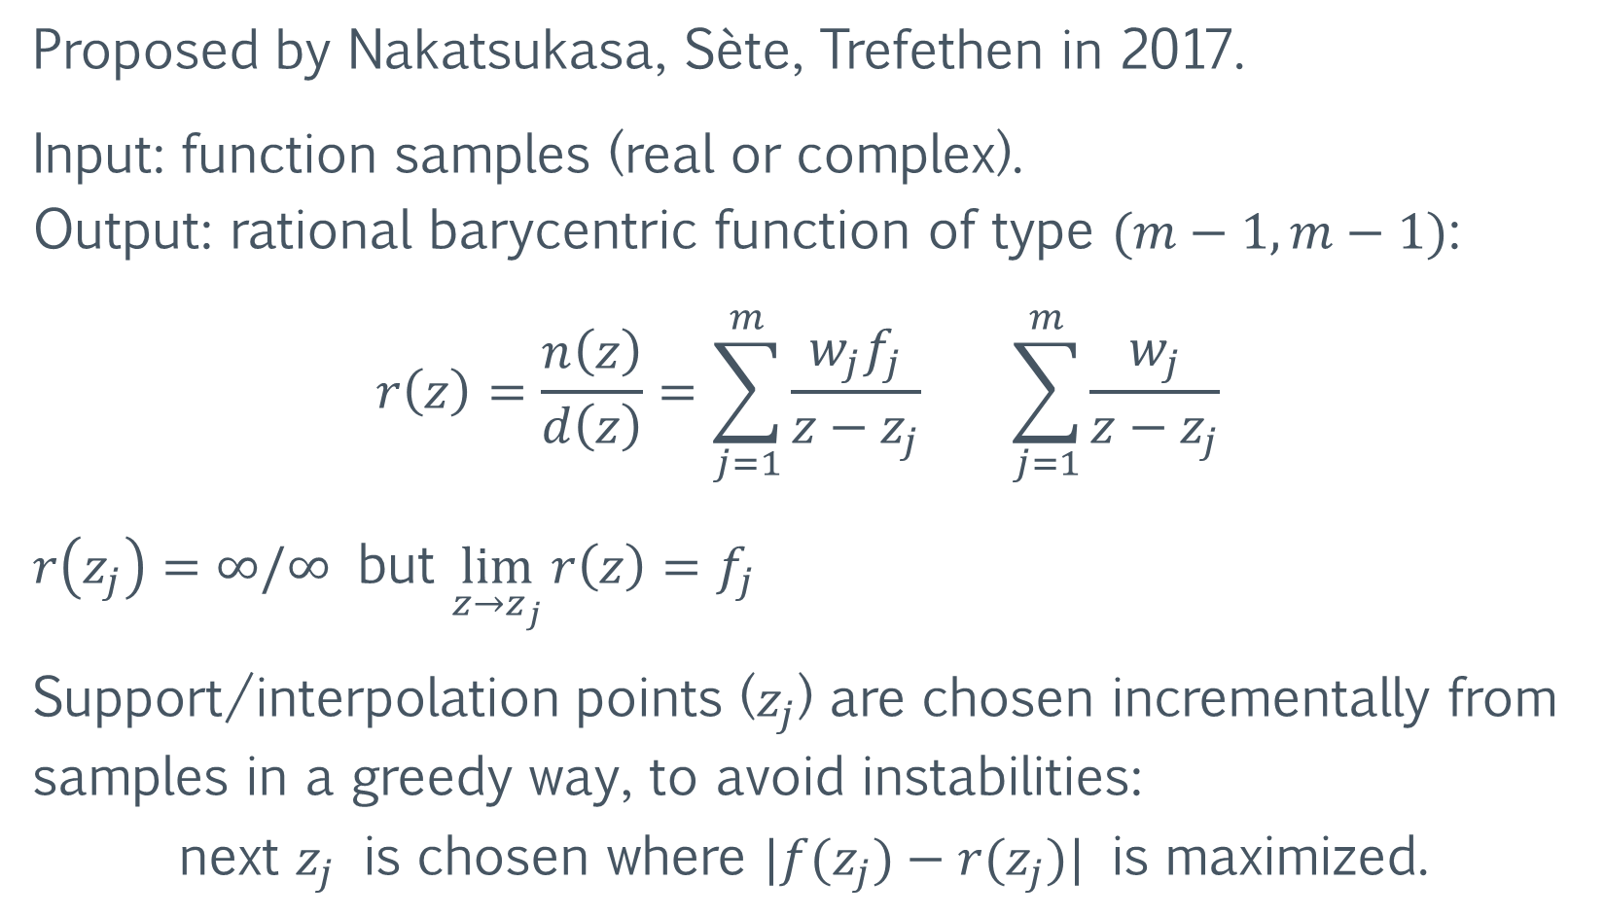
AAA algorithm for rational approximation
Proposed by Nakatsukasa, Sète, Trefethen in 2017.
Input: function samples (real or complex). Output: rational barycentric function of type $(m−1, m−1)$:
$$r\left(z\right)=\frac{n\left(z\right)}{d\left(z\right)}=\sum_{j=1}^{m}{\frac{w_{j}f_{j}}{z−z_{j}}} \sum_{j=1}^{m}{\frac{w_{j}}{z−z_{j}}}$$
$r\left(z_{j}\right)=∞/∞$ but $\lim_{z→z_{j}}{r\left(z\right)}=f_{j}$
Support/interpolation points ($z_{j}$) are chosen incrementally from samples in a greedy way, to avoid instabilities: next $z_{j}$ is chosen where $|f(z_{j})−r(z_{j})|$ is maximized.

Slide 18
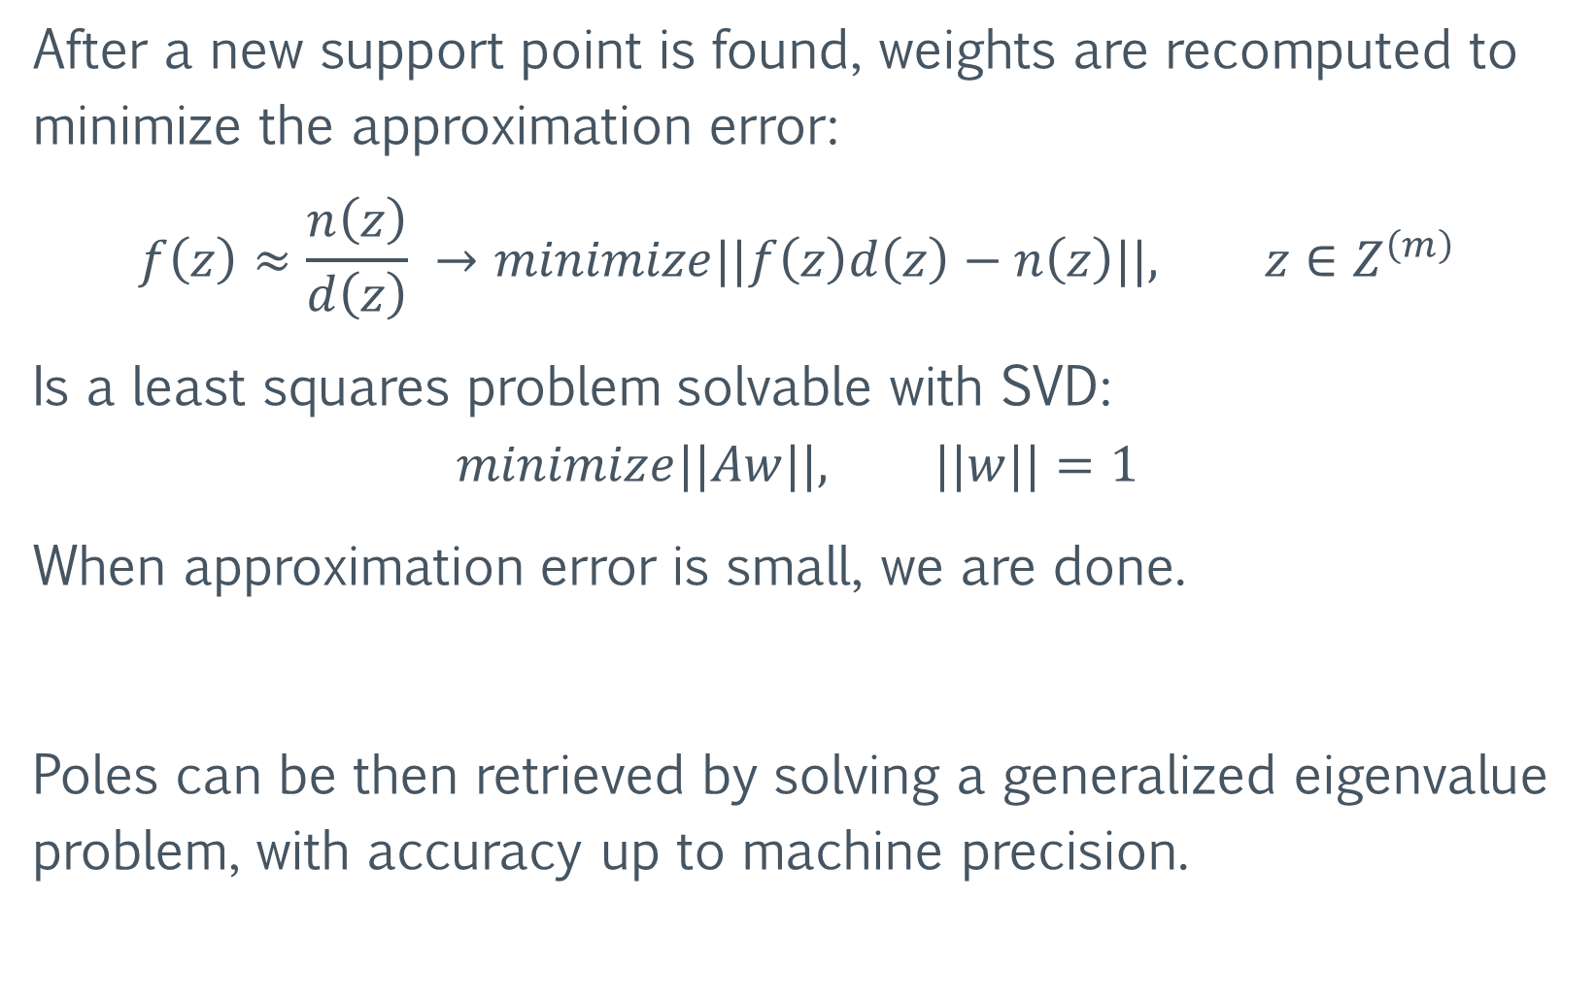
After a new support point is found, weights are recomputed to minimize the approximation error:
$$f\left(z\right)≈\frac{n\left(z\right)}{d\left(z\right)} →minimize||f\left(z\right)d\left(z\right)−n\left(z\right)||, z∈Z^{\left(m\right)}$$
Is a least squares problem solvable with SVD:
$$minimize||Aw||, ||w||=1$$
When approximation error is small, we are done.
Poles can be then retrieved by solving a generalized eigenvalue problem, with accuracy up to machine precision.

Slide 19
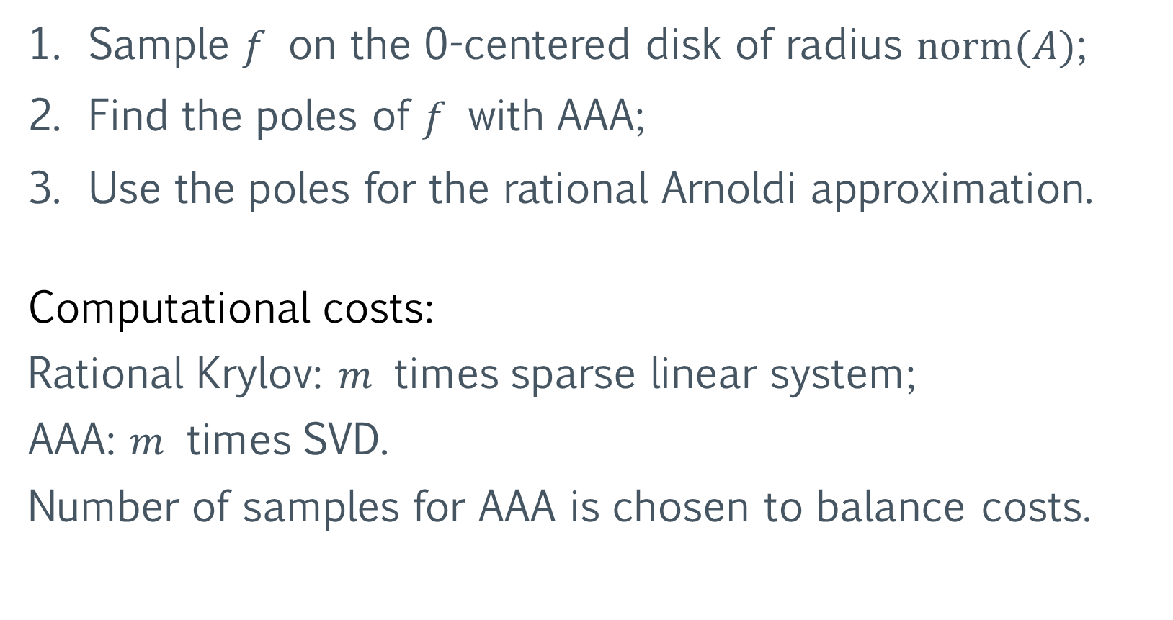
Rational Krylov + AAA
Sample $f$ on the 0-centered disk of radius $norm(A)$;
Find the poles of $f$ with AAA;
Use the poles for the rational Arnoldi approximation.
Computational costs:
Rational Krylov: $m$ times sparse linear system;
AAA: $m$ times SVD.
Number of samples for AAA is chosen to balance costs.

Slide 20

Rational Krylov + AAA, Experiment 1
Matrices are from the SuiteSparse Matrix Collection. $exp⁡(A)b$ with Krylov is compared with dense $expm$:
Problem type | name | cond(A) | cond (exp, A) | # poles | error | # poles | error
2D/3D problem | jagmesh3 | 1168 | 7.0e0 | 9 | 1.5e-6 | 15 | 6.0e-14
Fluid dynamics | sherman4 | 2178 | 1.2e2 | 11 | 6.6e-6 | 19 | 6.7e-10
Structural problem | can_1072 | 2.0e34 | 3.4e1 | 11 | 7.3e-6 | 23 | 1.7e-14
Directed graph | SmaGri | Inf | 7.8e1 | 9 | 2.6e-7 | 21 | 7.3e-13

Slide 21
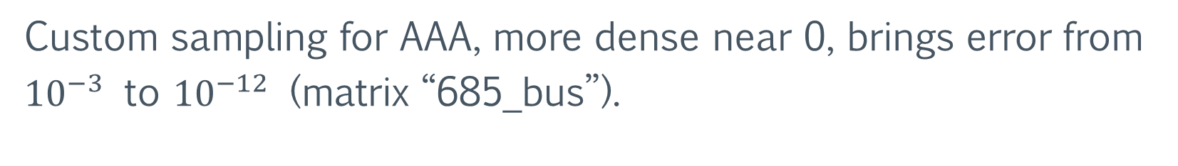
Rational Krylov + AAA, Experiment 2
$sqrt⁡(A)b$ (positive definite $A$) against dense $sqrtm$:
Problem type | name | min eig(A) | norm(A) | # poles | error | # poles | error
Circuit simulatio | rajat19 | 1.7e-1 | 3.9e1 | 20 | 5.8e-6 | 45 | 3.7e-14
Structural problem | nos3 | 1.8e-2 | 7.7e2 | 50 | 8.8e-4 | 100 | 5.2e-9
Power network | 685_bus | 6.2e-2 | 2.6e4 | 50 | 1.5e-3 | 95 | 8.0e-5
Electro magnetic | mhd 1280b | 1.5e-11 | 8.0e1 | 50 | 2.5e-2 | 50 | 8.8e-3
Custom sampling for AAA, more dense near 0, brings error from ${10}^{−3}$ to ${10}^{−12}$ (matrix “685_bus”).

Slide 22
Future Work
Different algorithms could be used for the evaluation of the diagonal blocks in Schur-Parlett (replacing Taylor).
An AAA solution could solve some of Schur-Parlett’s instability issues and lift the dependency on automatic differentiation, bringing the automatic algorithm to other languages such as Matlab and C (more research needed).

Slide 23

Future Work
Different algorithms could be used for the evaluation of the diagonal blocks in Schur-Parlett (replacing Taylor).
An AAA solution could solve some of Schur-Parlett’s instability issues and lift the dependency on automatic differentiation, bringing the automatic algorithm to other languages such as Matlab and C (more research needed).

Slide 24

Future Work
Different algorithms could be used for the evaluation of the diagonal blocks in Schur-Parlett (replacing Taylor).
An AAA solution could solve some of Schur-Parlett’s instability issues and lift the dependency on automatic differentiation, bringing the automatic algorithm to other languages such as Matlab and C (more research needed).
Questions?

